Slide 1

Blurred Lines and Distant Colleagues: Professionalism in the Flexible Work Era
(A Social Information Processing Approach)
Juliet E. Ikhide
Abertay University, Scotland, United Kingdom
ManaGlobal Final Conference
May 2024, Rennes (France)
Notes:
This project has received funding from the European Union’s Horizon 2020 research and innovation programme under grant agreement n°823744 - ManaGlobal ManaGlobal is an innovative research project (RISE). It seeks to explore the type of management approaches that are practiced in selected African and Arab countries. The aim of ManaGlobal is to contribute to a toplevel North-South cooperation through the development of a pioneering collaborative and networking team of African, Arab and European scholars and practitioners including business leaders, managers and institutional decisionmakers

Slide 2


Agenda
Presentation Overview
What -Introduction
Why-Literature Review
How-Methodology
So What-Conclusion
References
Contribution, Feedback and Thoughts

Slide 3

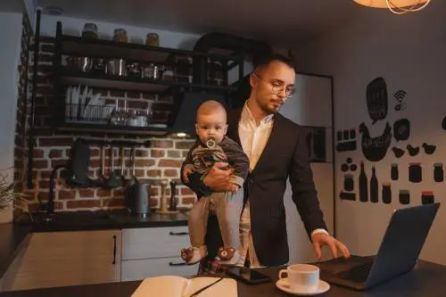




Think about the times…
You worked remotely
You worked from the office space
…how did those affect your Professionalism
Notes:
Professional is a broad term encompassing conduct that's expected in a work setting. It goes beyond just doing your job and extends to how you interact with colleagues, clients, and the organization as a whole. The specifics can vary depending on the industry, company culture, and your individual role, but some general principles apply:Belief in Public Service, professional autonomy, professional commitment, Belief in Self-regulation, Professional Organization as a Major Referent

Slide 4
What - Introduction
Background and Overview
The pandemic, work disruption
Favourable, unfavourable standpoint
Example
Supervision, social interaction, Limited L&D
Interplay of Demographic factors
  Variables
  Theory
  Social information processing theory (SIP)
  (Salancik & Pfeffer, 1978)
  Research Gap
  Professionalism perspective
  African context-social ties value
  Demographical variable's role, SIP
  (Professionals’ heterogeneity in a FWA)
  Effect of ‘other’ contacts in the ‘new’ work environment.
Flexible
work
arrangement
Professional
Isolation
Professionalism
Multi-group analysis based on Demographics e.g. Gender, Marital status, caring responsibility, family composition, Career Tenure, and Age
Notes:
Therefore, it is important to examine the effect of those contact in an individual’s environment specifically because social group/networks go beyond the formal social work boundaries which are limited to work group designations alone (McAlpine, 2015). Although, the rising trend in FWAs, which blur the line between personal and professional life, there is a dearth of empirical studies that considers the role of demographical variables such as marital status, caring responsibility, family composition, gender, age etc, that may influence the mediation relationship between FWA, and professionalism through professional isolation (Sahai et al., 2021). These demographical variables have been found to correlate with isolation in a FWA context but more research is required to fully comprehend their impact on other outcomes of professionals (Yu & Liu, 2022; Sahai et al., 2021). This study endeavours to address the gap by examining how the difference in demographics between professionals may influence the proposed mediation relationship.

Slide 5
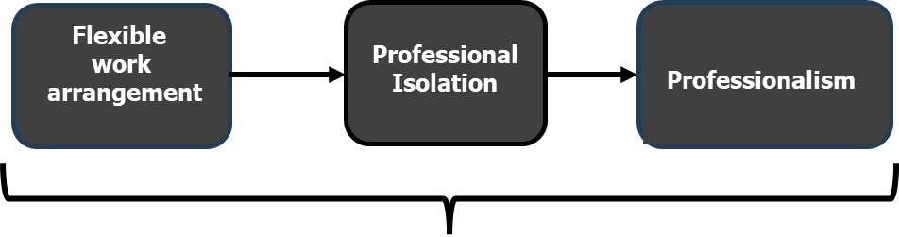
What - Introduction
Multi-group analysis based on Demographics e.g. Gender, Marital status, caring responsibility, family composition, Career Tenure, and Age
Research aim
Explore the relationship between…through …
…and assess possible variations across demographics/subgroups
Research question
Could FWA affect professionalism?
Does professional isolation mediate the direct relationship…?
How does the mediated relationship vary across professional subgroups/demographic?
Notes:
-Could FWAs which blurs the lines between personal and professional life impact professionalism, increase corrupt practices, or reduce effectiveness amongst professionals?
--Could professionalism among certain employee groups be reconfigured/redefined as a result of changing work environments and arrangement?
-What work practices or strategies can be used in managing employees' professional capability in the ‘new normal’ of work arrangement?

Slide 6



WHY – Literature Review Literature Review
Flexible Work Arrangement
  Not new-70’s, increase since pandemics (Cooper & Kurland, 2002)
  Flex-time and Flexplace (Shifrin & Michel, 2021)
  En masse FWA to enter African continent (Anwar & Graham, 2020).
  Non-tangibility of professional service
  White-collar, highly-skilled occupations
  Fluid professional work boundaries
  Example
  Corresponding challenges with benefits:
  Counterproductive/productive behaviour, work-life balance/conflict, isolation, knowledge sharing/hiding, overwork, data/confidentiality violations
  (Soga et al., 2022)
Notes:
FROM when (flex-time) –employees have control over their work time – job sharing, compressed work week , leave and from where (flexplace) –usually outside the traditional work space
White-collar, highly-skilled occupations-non-tangibility of professional service
While this development is not entirely new, for the first time, there is the possibility for FWA to enter en masse and quickly to the African continent (Anwar & Graham, 2020).
No study has examined organizational and individual factors that can facilitate corrupt practices or erode professional capability. This proposed study aims to address these gaps and provide evidence-based mitigation practices in the relationship between FWAs and employee professionalism. Upholding high standards of professionalism in the new order of work is crucial for society.

Slide 7
WHY – Literature Review Literature Review
Professionalism
Expert vocational knowledge, autonomy to deploy expertise,
ethical commitment, professional association, Societal welfare
Instrumental in societal development
  Practices affect clients/society
  Abreast on theory of practice (Fitzgerald, 2020)
  80% service sector employment, Economic output (Brien, 2022)
  Could be affected by :
  Geographical relocation, Digital dislocation -remote service delivery Noordegraaf (2016)
Professional isolation
Insufficiency of professional and social interactions
Formal or informal benefits
Learning, weakens engagement, commitment, and efficiency of professionals
Notes:
FROM when (flex-time) –employees have control over their work time – job sharing, compressed work week , leave and from where (flexplace) –usually outside the traditional work space
Noordegraaf (2016) argues that professionals' behaviour may be affected by developments that affect work pattern arrangements. Examples include geographical relocation, which enables professionals to deliver services remotely on a global scale, and digital dislocation, which facilitates the remote provision and consumption of professional services: both containing elements of flexitime and flexplace

Slide 8
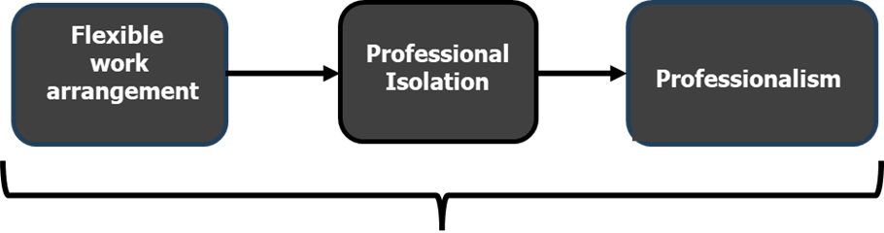
How-Methodology
Mixed method
Questionnaire , Interview
Samples
IT personnel, teachers, etc
Scales
Swailes’s (2003) Professionalism-24 items
I think that my profession, more than any other, is essential for society
I am my own boss in almost every work-related situation
Cooper et al.’s (2002) professional isolation -7 items
(Hu et al., 2022; Spilker et al., 2021)
I feel left out of activities and meetings that could enhance my career
I miss informal interaction with others
Hill et al.’s (2001) FWA-4 items
I have flexibility in selecting the location of where my work is performed.
Multi-group analysis based on Demographics e.g. Gender, Marital status, caring responsibility, family composition, Career Tenure, and Age
Notes:
FWA- I have complete flexibility in selecting the location of where my work is performed.
2 I have flexibility in scheduling when I do my work (e.g., scheduling hours, and time of day).
3 I have flexibility in scheduling what work I will do (e.g., the context of work processes used).
4 I have sufficient flexibility in my job to maintain adequate work and family life balance.
Professionalism – 5 subscales- Belief in Public Service, professional autonomy, professional commitment, Belief in Self-regulation, Professional Organization as a Major Referent
I think that my profession, more than any other, is essential for society
Some other occupations are actually more important to society than mine. (R)
I am my own boss in almost every work-related situation
I like this profession too well to give it up.
My fellow professionals have a pretty good idea about each other's competence
Professional isolation
I feel left out of activities and meetings that could enhance my career
I miss face-to-face contact with co-workers.
When the data is obtained, some preliminary analysis such as cleaning the data, conducting descriptive statistics, and checking the data distribution, will be performed. This is to identify patterns and anomalies in the data and to prepare the data for subsequent analysis. Analysis to check the construct validity and scale reliability will be done. Confirmatory factor analysis(CFA), will be used to verify the measurement quality used of variables e.g. FWA, professionalism, social isolation etc. This should not be a challenge. Goodness-of-fit tests using chi-square will also be conducted to assess the model fit, Since the proposed study intends to explore the effect of FWAs on professionals' behaviour and to investigate contextual factors such as organizational support, professional isolation, demographics, etc., that may weaken (or strengthen) the relationship, structural equation modelling (SEM) technique, regression, T-test and ANOVA analysis will be used to evaluate the relationships, including mediation, moderation, and differences between demographic means. Semi-structured interviews will be designed and analysed by the research assistant(RA). The principal applicant will conduct the interviews with few participants (number to be decided by the RA). This qualitative method will provide an avenue for in-depth conversation and delve into the nuances of the relationships between variables, which may not be fully captured by the quantitative method.

Slide 9

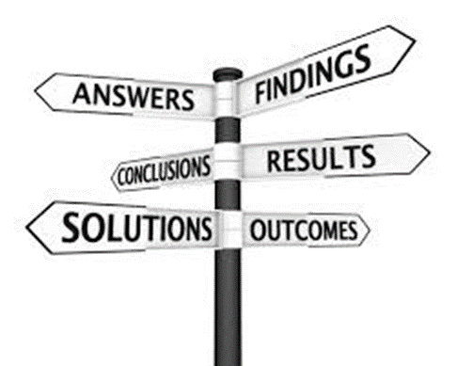
So, What- Conclusion
Intended (and possibly unintended) FWA consequences
Adopting organisations
Professionals
Comprehend Professionalism in the context of FWA
Navigating the changing work landscape
Ensuring strategies that maintain high professionalism
Considering demographics
Susceptibility of subgroups among Professionals to FWA outcomes
Do the relationships hold for every professional
  Understand differences based on specific characteristics
  Targeted intervention
Evidence-based insights, professional practices/standards
for stakeholders
Theoretical Implication
Notes:
These expected outcomes bear broader significance and would be valuable for employees and organizations adopting such arrangements. The study will provide evidence-based insights into: - How flexible work arrangements could influence the conduct of professionals. -The development of policies and practices related to flexible work arrangements that could be geared towards having a positive impact on the consumers of professional employee services and society in general. -Guidance that could inform stakeholders e.g., organizations, policymakers, employee representatives, and academia, in developing research and implementing effective hybrid/flexible work arrangements.

Slide 10

Any
Contribution, Feedback, and Thoughts ?

Slide 11

Thank you for listening…
Scan the QR code to connect on LinkedIn

Slide 12
References
Anwar, M. A., & Graham, M. (2020). Between a rock and a hard place: Freedom, flexibility, precarity and vulnerability in the gig economy in Africa. Competition & Change, 25(2), 102452942091447. https://doi.org/10.1177/1024529420914473
Brien, P. (2022). Service industries: Key Economic Indicators. Commonslibrary.parliament.uk. https://commonslibrary.parliament.uk/research-briefings/sn02786/#:~:text=The%20service%20industries%20accounted%20for
CIPD. (2023, December 13). CIPD | Flexible Working Practices | Factsheets. CIPD. https://www.cipd.org/uk/knowledge/factsheets/flexible-working-factsheet/#title4
Cooke, F., Dickmann, M., & Perry, E. (2023). Building a sustainable ecosystem of human resource management research: reflections and suggestions. The International Journal of Human Resource Management, 34(3), 459–477. https://doi.org/10.1080/09585192.2023.2165011
Cooper, C., Behavior, N. K.-J. of O., & 2002, undefined. (2002). Telecommuting, professional isolation, and employee development in public and private organizations. Wiley Online Library, 23 (SPEC. ISS.), 511–532. https://doi.org/10.1002/job.145
Hall, D. T. (2002). Careers in and out of organizations. Sage. https://books.google.com/books?hl=en&lr=&id=tTQ5DQAAQBAJ&oi=fnd&pg=PP1&dq=Hall,+D.T.+(2002),+Careers+In+and+Out+of+Organisations,+Sage,+Thousand+Oaks,+CA&ots=nxpH23ZIcF&sig=UXmY-GtJxkAL54S7uGRJzEdzC20
Hill, E. J., Hawkins, A. J., Ferris, M., & Weitzman, M. (2001). Finding an Extra Day a Week: The Positive Influence of Perceived Job Flexibility on Work and Family Life Balance*. Family Relations, 50(1), 49–58. https://doi.org/10.1111/j.1741-3729.2001.00049.x
Hu, X., Health, M. S.-S. and, & 2022, undefined. (2022). Understanding the impact of COVID‐19 pandemic on teleworkers’ experiences of perceived threat and professional isolation: The moderating role of friendship. Wiley Online Library, 38(5), 927–939. https://doi.org/10.1002/smi.3146
Noordegraaf, M. (2016). Reconfiguring professional work: Changing forms of professionalism in public services. Administration & Society, 48(7), 783–810. https://doi.org/10.1177/0095399713509242
Shifrin, N.V. and Michel, J.S. (2021) ‘Flexible work arrangements and employee health: A meta-analytic review’, Work & Stress, 36(1), pp. 1–26. Available at: https://doi.org/10.1080/02678373.2021.1936287.
Soga, L. R., Bolade-Ogunfodun, Y., Mariani, M., Nasr, R., & Laker, B. (2022). Unmasking the other face of flexible working practices: A systematic literature review. Journal of Business Research, 142, 648–662. https://doi.org/10.1016/J.JBUSRES.2022.01.024
Swailes, S. (2003). Professionalism: evolution and measurement. The Service Industries Journal, 23(2), 130–149. https://doi.org/10.1080/0264206041233130092

Slide 13
Genre et adoption des technologies numériques pendant la période de COVID-19 : le cas des entreprises camerounaises
Novice Patrick BAKEHE
André Modeste ABATE
Christiane Huguette SINGUI MBA

Slide 14
PLAN DE PRESENTATION
Contexte
Objectif et problématique
Revue de la littérature et hypothèses
Intérêt de la recherche
Méthodologie
Résultats
Conclusion et recommandations

Slide 15
Contexte (1)
Notes:
Dans un contexte de ralentissement économique, la crise de la COVID-19 a entrainé une explosion du commerce électronique et une accélération de la transformation numérique.
Selon le rapport de la CNUCED, la part du commerce électronique dans le commerce de détail mondial est passée de 14% en 2019 à environ 17% en 2020. Une augmentation de 3 points de pourcentage en 1 an.

Slide 16
Contexte (2)
Notes:
Le choc de la pandémie de la Covid-19 et les périodes de confinement ont également amené des profondes mutation de nos modes de travail. Par exemple, avant la crise sanitaire, le télétravail ne concernait que 4% des salariés en France, contre un peu plus de 25% en 2020. Ce phénomène n’est bien sûr pas spécifique à la France mais a concerné tous les pays. Le télétravail, souvent plébiscité par les employés concernés, pourrait ainsi perdurer et amener des gains potentiellement importants pour ces derniers mais également pour les entreprises.

Slide 17
Problématique et objectif
- Qu’elle est l’influence du sexe du dirigeant sur l’adoption technologies numériques dans les entreprises pendant la pandémie de COVID-19 ?
- L’objectif de cet article est d’analyser l’influence du sexe du dirigeant sur l’adoption des du télétravail et du commerce électronique en période de la pandémie de COVID-19 au Cameroun.
Notes:
Il existe des hétérogénéités entre les entreprises en ce qui concerne l’adoption des technologies numériq pendant la pandémie de COVID-19. Les travaux existants ont examiné ses facteurs explicatifs tels que les différences de capacités informatiq, tant au niveau de l’entreprise qu’au niveau géographiq. Cdt, très peu d’attention a été accordée au rôle du sexe des dirigeants d’entreprises dans l’analyse de l’adoption des technologies numériques. Or, selon les principes de la théorie des échelons supérieurs, ce sont les caractéristiques de l’équipe de direction qui définissent la vision à l’origine de choix stratégiq et donc de la performance de l’entreprise.

Slide 18
Revue de la littérature et hypothèses (1)
La littérature consacrée à la diffusion des technologies met en avant trois facteurs déterminants (Rogers, 2003 ; Erumban et De Jong, 2006 ; Lashitew et al., 2019) :
les facteurs liés à la demande
les facteurs liés à l’offre
les facteurs liés aux attributs managériaux
Notes:
Les facteurs de demande affectent le niveau d’attractivité des différentes technologies numériques pendant la pandémie, déterminant ainsi le succès des innovations dans un domaine. Une demande accrue de technologies numériques peut résulter de capacités informatiques plus fortes.
Les facteurs d’offre sont principalement des conditions d’accessibilité au réseau de qualité et aux investissements technologiques au sein des entreprises. Au-delà des forces de l’offre et de la demande, les caractéristiques des cadres supérieurs influencent l’adoption des technologies numériques. La « théorie des échelons supérieurs » développée par Hambrick et Mason (1984) postule que les résultats de l’entreprise seraient le reflet des caractéristiques démographiques et cognitives de ses principaux dirigeants telles que l’âge, le sexe et l’expérience. Ces facteurs jouent donc un rôle essentiel dans la décision d’adoption et l’utilisation des nouvelles technologies.

Slide 19
Revue de la littérature et hypothèses (2)
Hypothèse 1. Les entreprises dirigées par des femmes sont moins susceptibles d’adopter le travail à distance pendant la pandémie de COVID-19.
Hypothèse 2. Les entreprises dirigées par des femmes adoptent moins le commerce en ligne pendant la pandémie de COVID-19.
Notes:
Le choix d’investir dans les technologies numériques au milieu d’une double crise (économique et sanitaire) reflète un goût du risque relativement élevé. Des recherches antérieures ont mis en évidence l’influence du genre sur la prise de risque, les hommes chefs d’entreprise ayant un goût plus prononcé pour le risque que les femmes chefs d’entreprise. Par exemple, en utilisant les données des entreprises européennes, certains auteurs ont montré que les femmes chefs d’entreprise dirigent plus des structures moins risquées.
L’aversion au risque chez les femmes chefs d’entreprise pourrait être particulièrement élevée en période de crise et d’incertitude. Nous formulons donc les hypothèses suivantes:

Slide 20
Intérêt de la recherche
Contribution à la littérature sur la relation entre le sexe du dirigeant et l’adoption des technologies numériques au cours de la pandémie de COVID-19.
Contribution à la littérature qui cherche à comprendre les facteurs explicatifs de l’adoption des technologies pendant la pandémie en étudiant pour une première fois le cas d’un pays d’Afrique subsaharienne.
Notes:
Notre étude contribue à la littérature de la manière suivante. D’une part, cette étude contribue à la littérature encore rare sur la relation entre le sexe du dirigeant et l’adoption des technologies numériques.
D’autre part, notre article contribue à la littérature qui cherche à comprendre les facteurs qui expliquent l’adoption des technologies par les entreprises pendant la pandémie, jusqu’à maintenant fortement dominée par les études dans les pays développés ou émergents. En analysant les données camerounaises, notre étude participe ainsi à la réflexion pour une première fois sur le cas d’un pays d’Afrique subsaharienne.

Slide 21
Méthodologie (1)
1. Données
Les données proviennent l’Enquête du Ministère des Petites et Moyennes Entreprises, de l’Economie Sociale et de l’Artisanat.
L’enquête du premier semestre a concerné 261 entreprises alors que celle de second semestre a pris en compte 297 entreprises.
Notes:
Les données utilisées proviennent de l’enquête du Ministère des Petites et Moyennes Entreprises, de l’Economie Sociale et de l’Artisanat réalisée auprès des PME sur la période du 15 Avril au 15 Mai 2020 et du 15 janvier au 15 février 2021 couvrant les activités du 1er et 2nd semestre 2020. L’enquête du premier semestre a concerné 261 entreprises alors que celle de second semestre a pris en compte 297 entreprises. Ce qui fait un total de 558 entreprises.

Slide 22

Méthodologie (2)
Nous estimons l'équation suivante :
${Techno}_{i}=\left\{\begin{aligned}1 si {Techno}_{i}^{∗}=α{Sexe}_{i}+βX_{i}+u_{i}>0 \\ 0 sinon \end{aligned}\right.$
Notes:
〖Sexe〗_i représente le sexe du dirigeant de l’entreprise, Xi les variables explicatives et α et β représentent les coefficients qui seront estimés

Slide 23
Résultats
Notes:
Les résultats de la colonne 1 montrent que l’adoption du travail à distance est significativement plus faible dans les entreprises ayant une femme comme dirigeant. Ce résultat confirme ceux déjà mis en évidence par Lashitew (2023) à partir d’un échantillon de 44 pays. Les effets marginaux montrent que, par rapport aux entreprises dirigées par des hommes, la probabilité d’adopter le travail à distance diminue de 8 points pour les entreprises dirigées par des femmes. Ce résultat soutient notre première hypothèse selon laquelle les entreprises dirigées par des femmes sont moins susceptibles d’adopter le travail à distance pendant la pandémie de COVID-19. Cependant, les résultats montrent qu’il n’y a pas de différence significative entre les entreprises dirigées par les femmes et celles dirigées par des hommes en ce qui concerne l’adoption du commerce électronique.

Slide 24
Discussion et recommandations
Les pouvoirs publics doivent donc mettre un accent particulier aux entreprises dirigées par dans des femmes dans leurs politiques d’encouragement de l’adoption des technologies numériques.
Réduire les normes patriarcales qui augmentent la propension des filles à étudier les sciences sociales plutôt que les sciences naturelles (Lashitew, 2023). Dans ces conditions, les femmes chefs d’entreprise ont une probabilité plus élevée à se retrouver avec une expérience limitée dans les domaines scientifiques et technologiques (Baron et al., 2007), ce qui pourrait négativement influencer leur capacité à prendre des décisions risquées en faveur d’une transformation radicale telle que l’adoption du travail à distance.
Notes:
Notre résultat peut être expliqué par le fait que les hommes choisissent généralement des objectifs, telles que l’affirmation de soi, l’agressivité et l’autonomie, tandis que les femmes affichent des qualités pro-sociales et communautaires telles que la connectivité, la gentillesse et la bienveillance. Les travaux en psychologie mettent en avant le rôle de l’émotion dans l’explication de ces différences : les hommes ont tendance à avoir une confiance excessive en leurs propres capacités, ce qui augmente potentiellement leur goût du risque. En revanche, les femmes ont généralement des réactions affectives plus fortes, comme la peur et la colère, en cas de résultats négatifs, ce qui pourrait considérablement augmenter leur aversion au risque. En outre, l’initiation pour la fille à se préoccuper des autres pourrait conduire à un leadership féminin conservateur et réticent à remettre en question et à transformer les pratiques de travail établies.

Slide 25
MANAGLOBAL
CONFERENCE FINALE
RENNES France
MAI 2024
Par Christiane Huguette SINGUI MBA
Doctorante
ESSEC – UNIVRESITE DE DOUALA – CAMEROU

Slide 26
Plan
1- Contexte , problématique et objectif de recherche
2- Cadre théorique
3- Cadre méthodologique
4- Principaux résultats
5- Contributions et implications
6- Perspectives

Slide 27
1- Contexte, Problématique et Objectif de recherche
  1/ Impact généralement négatif de la pandémie de COVID-19 sur l'économie mondiale (OMS, BM, BAD, FIMI, etc).
  2/ Les défis rencontrés par les entreprises, en particulier les petites entreprises, dans le contexte de la crise sanitaire et économique.
  3/ L’agilité offre aux organisations, la capacité de répondre de manière rapide et efficace aux changements non anticipés et aux distorsions produits par l’environnement externe (Charbonnier-Voirin, 2011).
  4/ Les résultats de deux études réalisées en France en 2021:
    Selon les résultats d’une étude Vistaprint, réalisée avec l'Institut d'étude OnePoll auprès de 500 chefs d'entreprise de TPE de moins de 9 employés sur la période du 8 au 12 mars dernier 2021, Il en ressort qu'un an après, les TPE françaises ont su s'adapter et mettre en place des stratégies pour résister à la crise.
    L’enquête conduite par l'IFOP et MasterCard publiée le 5 février 2021 révèle que la crise sanitaire a servi d'amorce à la digitalisation des TPE. Mais que celle-ci reste perçue comme une contrainte et non comme une perspective motivante.
  La présente recherche vise alors à explorer les transformations que les petites entreprises africaines ont initiées pour d’une part voir si elles ont été guidées par la nécessité ou alors considérées comme une opportunité et d’autre part voir selon le cas l’impact sur la performance financière et commerciale.

Slide 28
Cadre théorique et conceptuel
Le concepte et les s attributs de l’agilité
Si le concept est de plus en plus attractif, les définitions et les modèles nombreux trahissent l’évidence d’une absence d’unanimité.
Les débat théoriques sur l’agilité ont permis le développement des modèles empiriques, tentant sa théorisation (Bottani, 2010 ; Crocitto & Youssef, 2003 ; Gunasekaran, 1999; Yusuf et al., 1999).
Les attributs de l’agilité :
    Réactivité Sharifi et zhang (1999)
    Proactivité Gunasekaran (1998)
    Flexibilité Sharifi et al., (2001)
    Rapidité Zhang et al, (2011)
    Nécessité, Urgence, Imprévu Barrand (2006)
    Reconfiguration M’bouna et Tchankam (2021) ; (Fotso, 2022)

Slide 29
Cadre théorique
L’agilité en contexte de crise
L’agilité est devenue une nécessité majeure pour les entreprises pour faire face aux situations de crise (Combalbert, 2012).
Cependant Fotso (2022) trouve deux limites dans la littérature et les études autours de ce concept. Premièrement, ils pointent le fait que d’agilité n’ai été jusqu’ici très peu étudié dans les PME. Deuxièmement, ils relèvent que les études existantes ont essayé d’opérationnaliser le concept sans pour autant mettre en évidence un lien avec la performance.
Berkani et Tran (2021) indiquent que la crise actuelle (Covid-19) peut donc être un accélérateur de la généralisation des méthodes et pratiques agiles, afin de favoriser de façon systémique l'adaptation continue de l'organisation.
Sinapin (2020) a montré que diverses entreprises françaises ont fait preuve d’agilité pendant la période de covid-19 en France. Causse et Biwolé (2018) ont également retrouvé cette caractéristique dans les entreprises Africaines.
Les stratégies d’agilité des petites entreprises en contexte de covid-19
les résultats d’une étude Vistaprint, réalisée avec l'Institut d'étude OnePoll auprès de 500 chefs d'entreprise de TPE montrent que 77 % ayant adapté ou ajouté de nouvelles offres de produits ou de services à leur activité, 60 % ont créé ou mis à jour la présence de leur entreprise en ligne, 58 % ont adapté ou ajouté de nouvelles offres de services ou de produits, 51 % ont ciblé un nouveau type de clients, 48 % ont commencé à vendre leurs produits ou services en ligne et 46 % ont mis en place un paiement sans contact en raison des préoccupations d'hygiène concernant l'échange d'espèces, un chiffre qui monte à 80 % dans la région.

Slide 30
Cadre théorique et conceptuel
Cadre conceptuel
Les Hypothèses
Hypothèse 1 : la période de crise favorise l’agilité des entreprises
Hypothèse 2 : les entreprises africaines traditionnelles (informelles) et de petites tailles sont plus agiles que les entreprises modernes et de grandes tailles.
Hypothèse 3 : en contexte de crise, l’agilité est une stratégie de performance.
Hypothèse 4 : les entreprises africaines sont capables de développer des stratégies d’agilité face à la crise.
Crise
Agilité de l’entreprise
Performance
H3
COVID-19
H1
Stratégie d’agilité ou de Changement d’activité
Amélioration de la performance
H2
H4
Type d’entreprise

Slide 31
Cadre Méthodologique
Echantillonnage
Considérant l’objet de l’étude, à savoir apprécier l’agilité des entreprise des entreprises africaines en période de crise, nous avons comme l’indique Biwolé et Causse (2022) considérée que l’économie africaine est composée d’entreprises africaines modernes (enregistrées) et d’entreprise africaines traditionnelles (informelles, non enregistrées relevant du régime fiscale de l’impôt libératoire).
La construction de notre échantillon est en cohérence avec les données du deuxième Recensement Général des Entreprises (RGE) réalisé en 2016 par l’Institut National de la Statistique (INS) qui montrent qu’il y a plus d’entreprises informelles que des entreprises formelles.
Composition
Notre étude empirique porte sur 164 entreprises localisées au Cameroun.
Entreprises africaines modernes (formelles, enregistrés) : (N = 53)
Entreprises africaines traditionnelles (informelles, non enregistrées, relevant de système fiscal de l’impôt libératoire) : (N = 111)

Slide 32
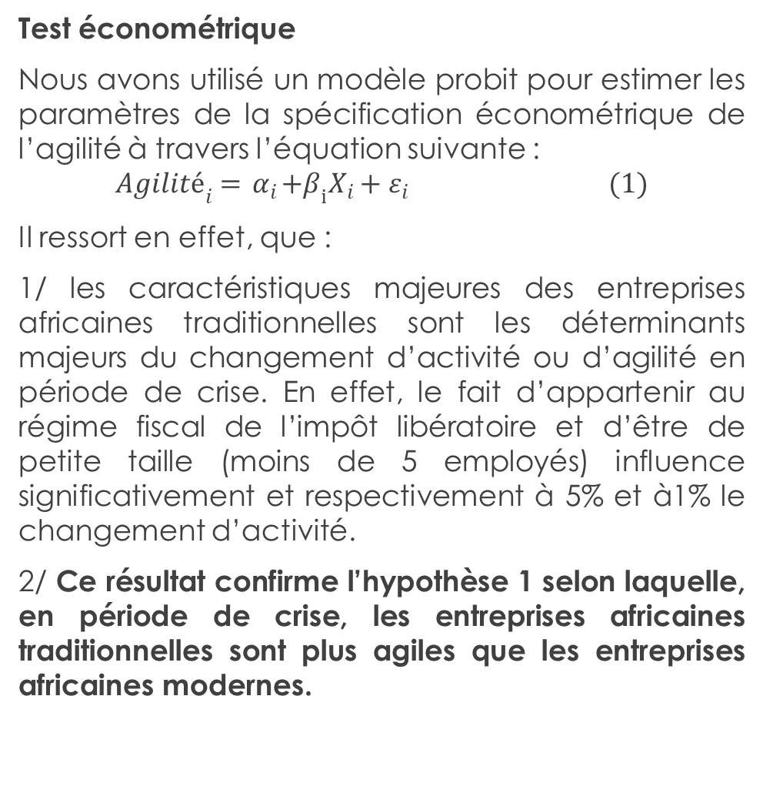
Principaux résultats
Test économétrique
Nous avons utilisé un modèle probit pour estimer les paramètres de la spécification économétrique de l’agilité à travers l’équation suivante :
$${Agilité}_{i}={ α}_{i}+β_{i}X_{i}+ε_{i} (1)$$
Il ressort en effet, que :
1/ les caractéristiques majeures des entreprises africaines traditionnelles sont les déterminants majeurs du changement d’activité ou d’agilité en période de crise. En effet, le fait d’appartenir au régime fiscal de l’impôt libératoire et d’être de petite taille (moins de 5 employés) influence significativement et respectivement à 5% et à1% le changement d’activité.
2/ Ce résultat confirme l’hypothèse 1 selon laquelle, en période de crise, les entreprises africaines traditionnelles sont plus agiles que les entreprises africaines modernes.
Agilité des entreprises en contexte de crise
L’hypothèse 1 soutient que la crise favorise l’agilité des entreprisse en Afrique.
Test univarié : statistiques descriptive
Changement d'activité | Nombre | %
Oui | 60 | 36,59%
Non | 104 | 63,41%
Total | 164 | 100,00%
Ainsi, les données ci-dessous confirment cette hypothèse. Le contexte crise est un accélérateur de changement. Il s’agit pour toutes les catégories d’entreprises d’une stratégie de survie et de résilience.

Slide 33
Principaux résultats
Les stratégies commerciales de changement des activités
L’hypothèse 4 de notre étude vise à explorer les capacités stratégiques des entreprises africaines en contextes de crise.
20,41% des entreprises de notre échantillon qui ont changé d’activité affirment avoir ajouté de nouveaux produits à leur ligne habituelle.
64,35% des entreprises ont ainsi développé une nouvelle organisation logistique notamment pour continuer à livrer la distribution par les motos-taxi, multiplier les zones géographiques de distribution pour échapper aux contrôles.
Statut fiscal et agilité des entreprises africaines
L’hypothèse 2 postule que les entreprises africaines traditionnelles sont plus agiles que les entreprises modernes pour ce faire, nous avons effectués les tests statistiques.
Test bivarié : test de corrélation
Le test de Khi 2 montre qu’il y a un lien positif et significatif entre le fait d’être une entreprise informelle et le changement d’activité en période de crise. Ce résultat confirme que l’entreprise africaine traditionnelle est plus agile que l’entreprise africaine moderne.
Stratégie | Nombre | % | Cumul
Produits nouveaux (de lutte contre la covid-19) | 10 | 20,41% | 20,41%
Nouveaux canaux de distribution, positionnement (implantation géographique) | 33 | 67,35% | 87,76%
Garder le contact et la proximité | 6 | 12,24% | 100,00%
Total | 49 | 100,00%
Changement d'activité | Entreprise moderne | Entreprise traditionnelle | Total
Non | 51 | 53 | 104
Oui | 17 | 43 | 60
Total | 68 | 96 | 164
Pearson chi2(1) |  | 6.7205
Signification |  | 0.010

Slide 34
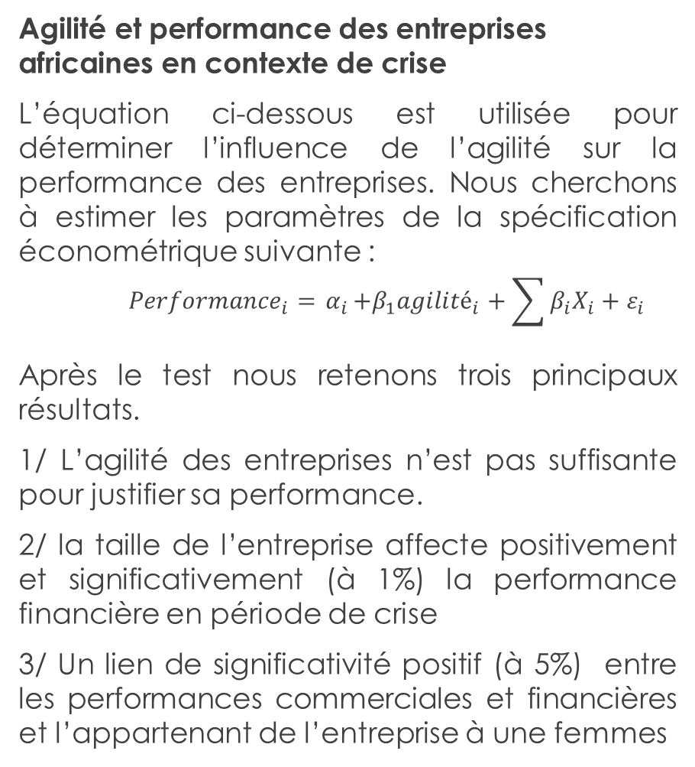
Principaux résultats
Agilité et performance des entreprises africaines en contexte de crise
L’équation ci-dessous est utilisée pour déterminer l’influence de l’agilité sur la performance des entreprises. Nous cherchons à estimer les paramètres de la spécification économétrique suivante :
$${Performance}_{i}={ α}_{i}+β_{1}{agilité}_{i}+\sum{β_{i}X_{i}}+ε_{i}$$
Après le test nous retenons trois principaux résultats.
1/ L’agilité des entreprises n’est pas suffisante pour justifier sa performance.
2/ la taille de l’entreprise affecte positivement et significativement (à 1%) la performance financière en période de crise
3/ Un lien de significativité positif (à 5%) entre les performances commerciales et financières et l’appartenant de l’entreprise à une femmes

Slide 35
Contributions et implications
Contributions
L’entreprise africaine traditionnelle( informelle) : un modèle agile en période de crise
La taille du secteur informel augmente en période de crise et ne diminue pas en temps de prospérité.
Les stratégies d'agilité mises en œuvre par les petites entreprises pour surmonter les défis de la COVID-19vont forgé leur résilience.
L’agilité ne permet pas de de différencier la performance selon le statut moderne ou traditionnel de l’entreprise
L’opportunité d’agilité de l’entreprise africaine en période de crise: une stratégie suffisante mais non suffisante pour garantir la performance
Les propriétaires des entreprises informelles agissent autant par opportunité, que par nécessité,
Les propriétaires des entreprise traditionnelles ont des capacités stratégique et dynamiques

Slide 36
Implications
  Recommandations pratiques pour renforcer l'agilité et la résilience des petites entreprises et les aider à naviguer avec succès dans les périodes de crise futures.
  Pour gérer les crises les entreprise traditionnelles doivent adopter des approches réactivent qui peuvent consister aux changement d’activités à travers diverses stratégies commerciales ( diversifier les offres , développer des relations avec les clients, tisser des partenariat…)
  Intégrer les connaissances acquises pendant la crise comme une possibilité de succès qui nécessite une attitude entrepreneuriale positive.
  Les stratégies commerciales mise en œuvre par les entreprises dans le cadre des changements de leurs activités pendant la période de crise de la covid-19 piliers essentiels de succès pendant la crise, doivent constituer un modelé d’apprentissage dans la période post-crise.

Slide 37
Perspectives
La gestion de la crise et notamment son impact sur la performance doit davantage mobilisé les chercheurs.
Il est important d’explorer comment les entrepreneurs ont intégrer les stratégies de résilience pendant la crise à une période post crise.

Slide 38
MERCI POUR VOTRE AIMABLE ATTENTION !!!

Slide 39
Influence de la disponibilité d’une connexion internet sur la précarisation de l’emploi
PEKETI Mindourewa

Slide 40
PLAN
I-Une brève histoire des TIC (technologies de l’information et de la communication)
II-Les apports des TIC
III-Les retombées des TIC sur les agents économiques
IV-Question de recherche et hypothèse
V-Estimations économétriques et résultats
VI-Conclusion

Slide 41
I-Une brève histoire des TIC (technologies de l’information et de la communication)
Du point de départ et aux réseaux de télécommunications actuels : fin 18ème siècle à nos jours.

Slide 42
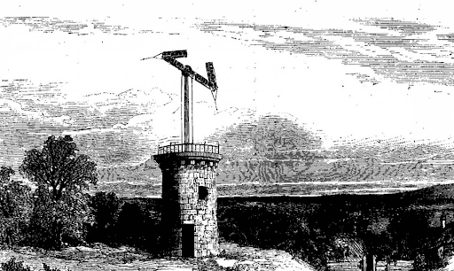
Le télégraphe de Claude Chappe (18ème sicle)

Slide 43
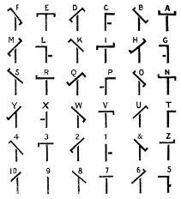

Slide 44
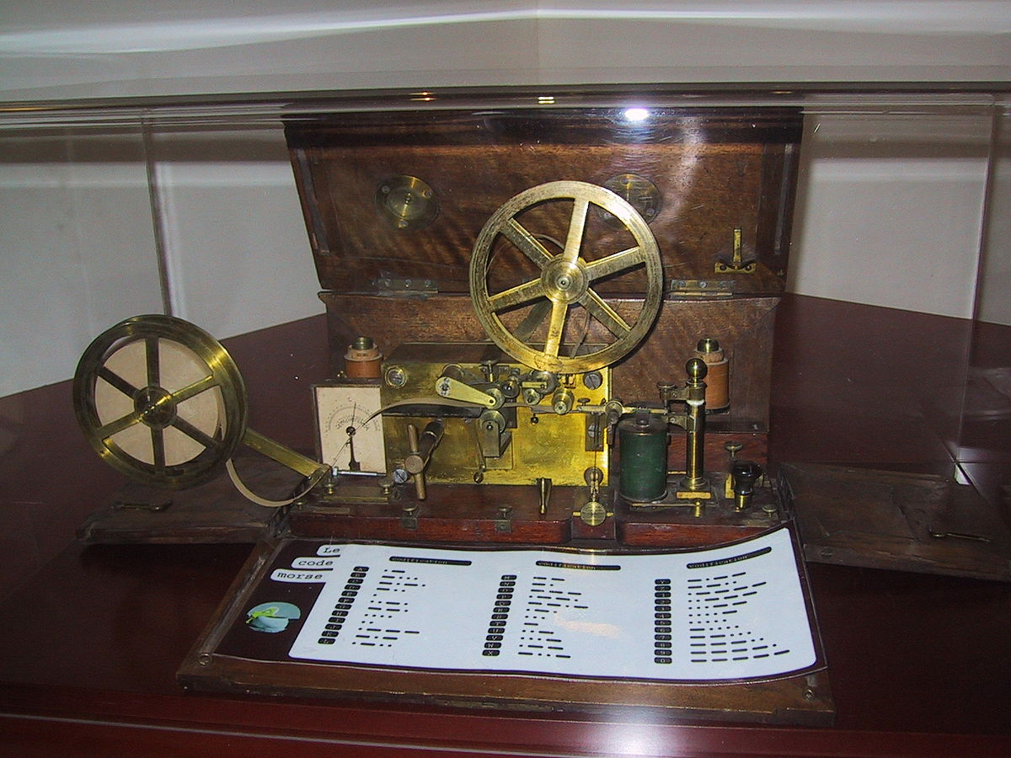
Télégraphe électrique de Morse (1837)

Slide 45
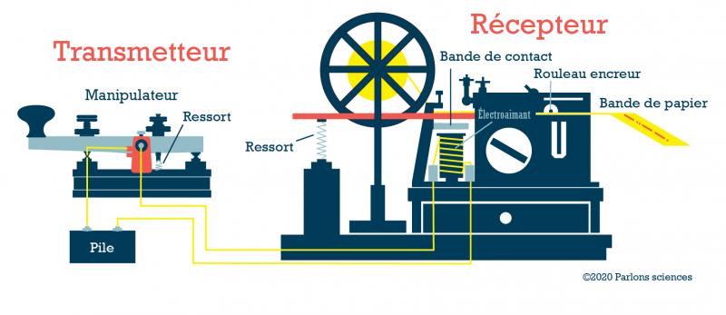

Slide 46
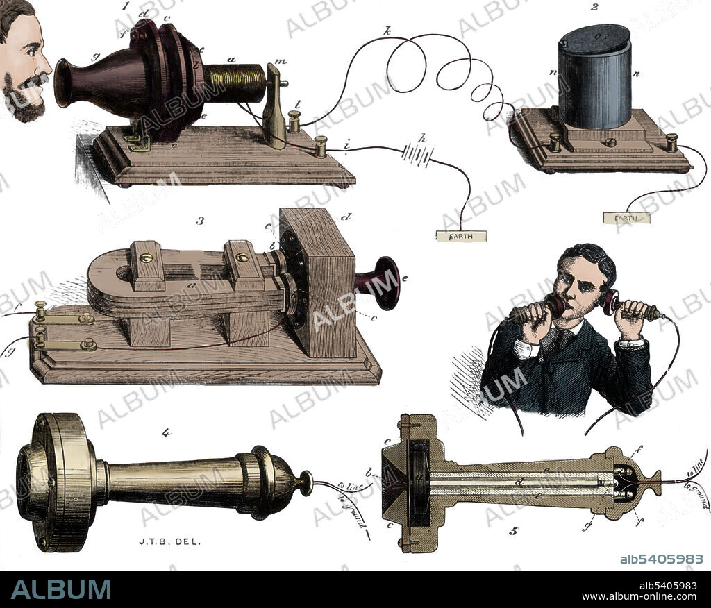
Téléphone fixe de Bell Graham (1876)

Slide 47
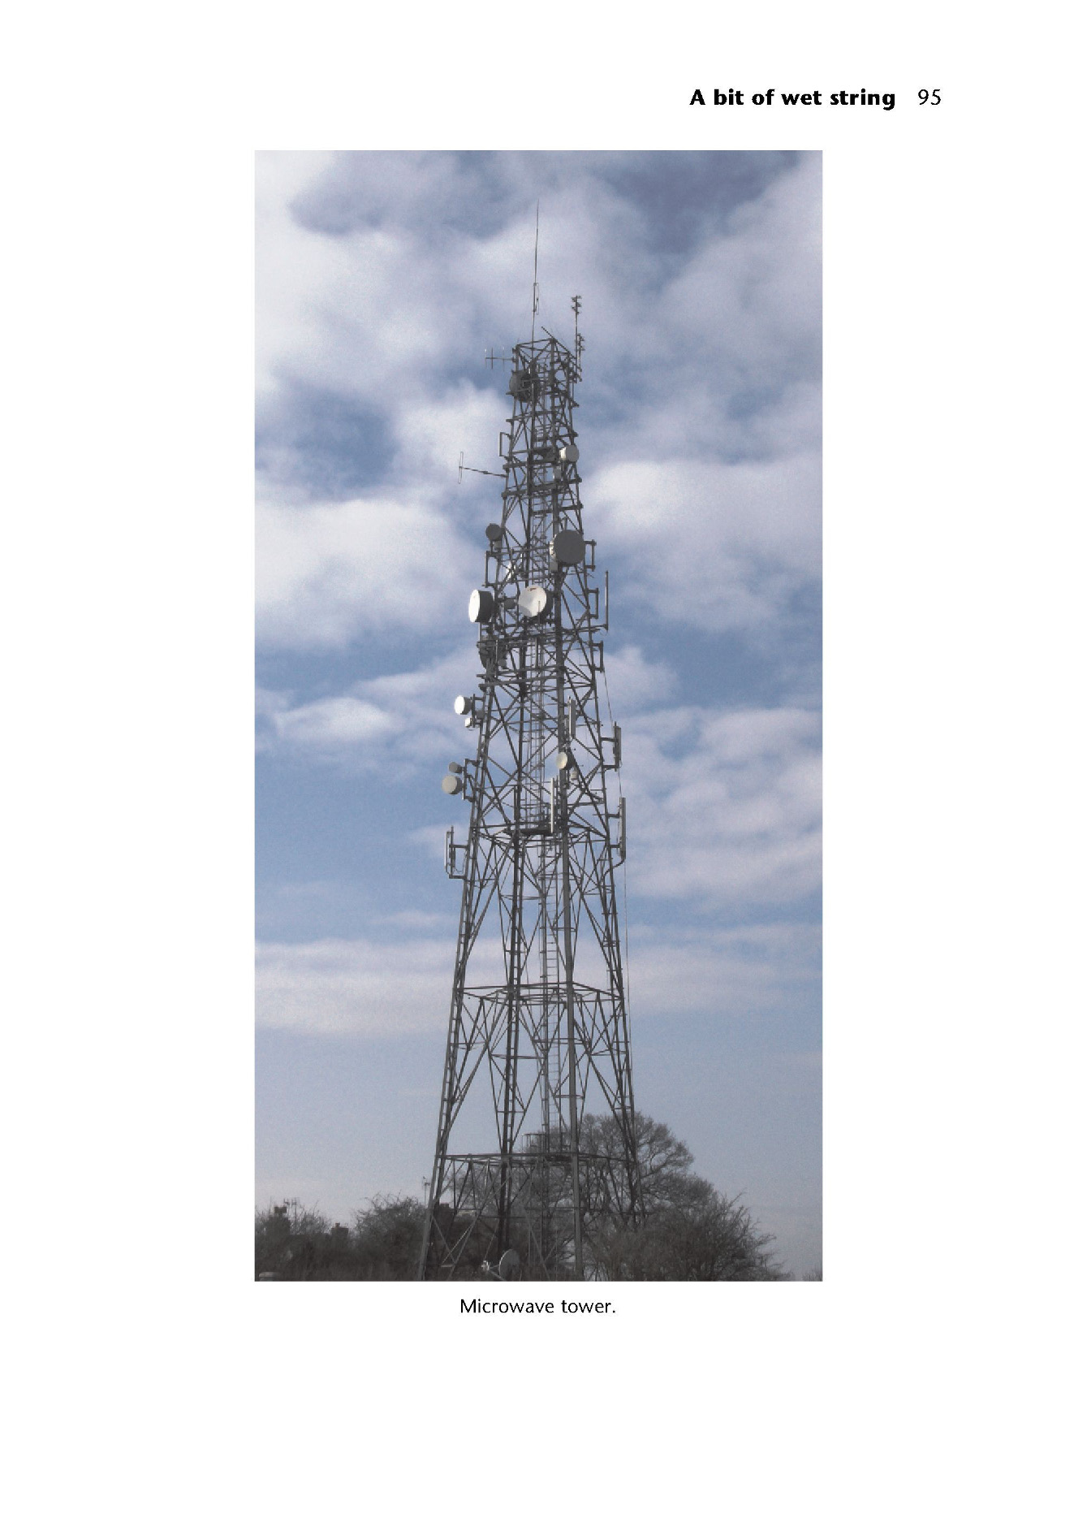
Télégraphe sans fil (Marconi, 1901)

Slide 48
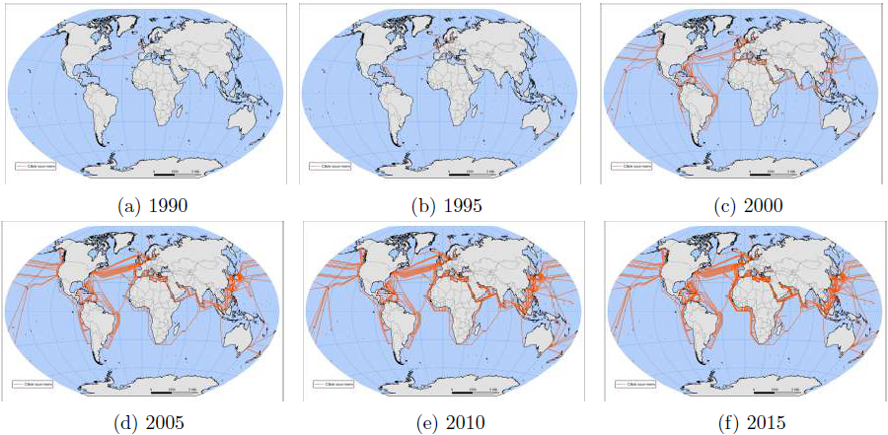
Réseaux de télécommunications en fibre optique (à partir de1987)

Slide 49
II-Les apports des TIC
Réduction des coûts de production d’une information (texte, vidéo, image, son, etc.)
Réduction des coûts de mise à disposition, d’accès, de recherche et de partage d’une information (exemple: Google, email, réseaux sociaux, etc.)
Réduction des coûts de réplication d’une information (exemple)
Réduction des coûts de suivi et de vérification (information, contrat, etc.)

Slide 50
III-Les retombées des TIC sur les agents économiques
Ménage (fonction économique : maximisation de l’utilité sous la contrainte du budget) :
  Télétravail (réduction du temps et des frais de déplacements professionnels, réduction de la pollution, etc.)
  E-commerce (réduction des déplacements liés aux achats, facilitation des achats, prix compétitifs, concurrence entre vendeurs à l’échelle internationale)
  Nouveaux biens et services numériques (smartphones, voitures autonomes, livraison à domicile, réseaux sociaux, streaming, etc.)
  Nouvelles opportunités d’emplois : secteurs secondaire et surtout des services

Slide 51
Etat (fonction économique : offre de services publics à partir des impôts): facilitation de la collecte des impôts et dématérialisation de la fourniture de nombreux services publics, etc.
Entreprise (fonction économique: maximisation du profit sous la contrainte des coûts de production)
  Augmentation du rendement du capital : nouvelles opportunités d’activités, équipements informatiques et nouvelles machines, utilisation des TIC dans le processus de production, etc.
  Offre d’emploi en fonction de l’évolution du capital Problématique pour le marché du travail

Slide 52
IV-Question de recherche et hypothèse
Question initiale : Comment la disponibilité et l’utilisation des TIC influence l’offre de travail au Cameroun ?
Revue de littérature : cette question a déjà été abordée par Autor et al. (2003), Reijnders et de Vries (2018), Michaels et al. (2014), Balsmeier et Woerter
(2019), etc…
Résultats: l’augmentation de l’utilisation d’internet ou part du capital TIC Polarisation de l’emploi substitution des travailleurs moyennement instruits par des travailleurs hautement instruits et maintien des travailleurs peu qualifiés (tâches manuelles)

Slide 53
Question de recherche finale : comment la disponibilité d’une connexion internet contribue à la précarisation de l’emploi au Cameroun
Pourquoi : la base de donnée n’indique que des informations sur le nombre d’employés temporaires et permanents (pas sur les catégories)
Cohérence avec les travaux précédents : la polarisation sur le marché du travail est aussi synonymes de la précarisation de l’emploi pour certains travailleurs
Hypothèse: relation négative et significative entre la part de l’emploi permanent et la disponibilité ou l’utilisation d’internet

Slide 54
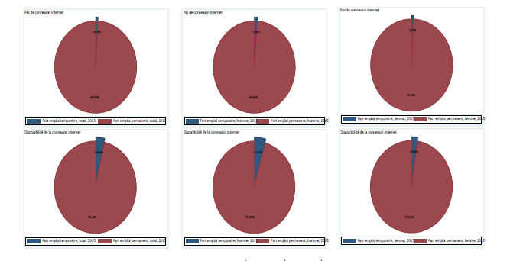
Justifications de l’hypothèse

Slide 55
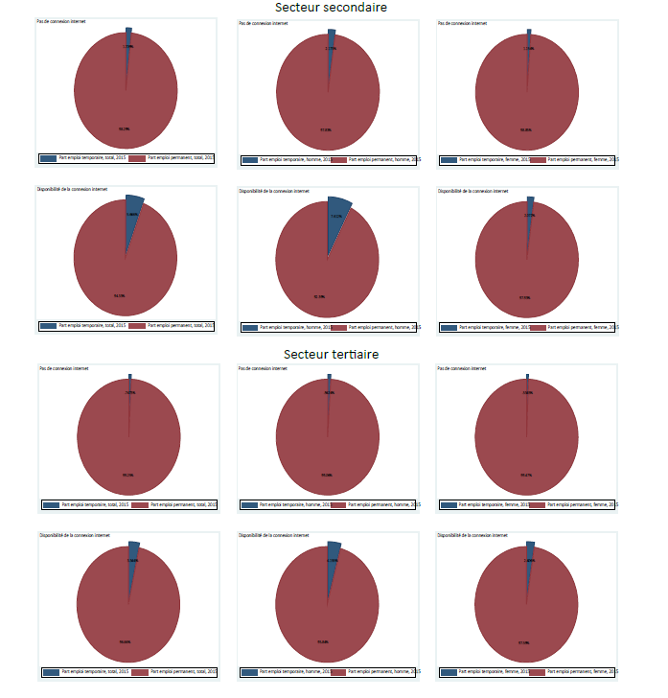

Slide 56
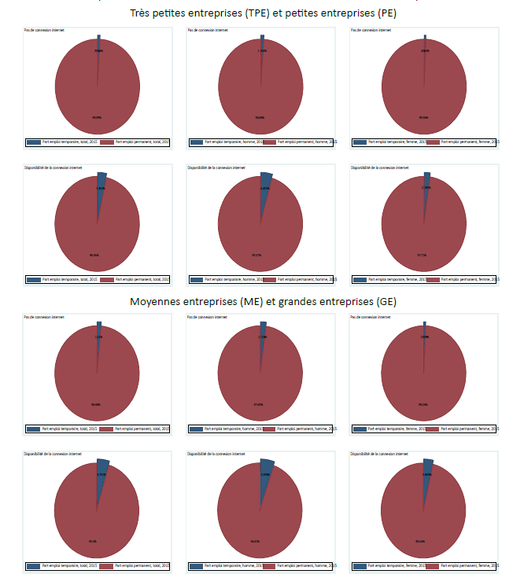

Slide 57
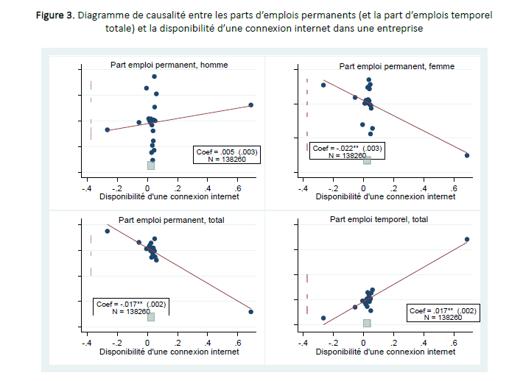

Slide 58
V-Estimations économétriques et résultats
Les employés temporaires sont des « travailleurs à temps partiel ou temporaires, les personnes dont le nombre d’heures travaillées est inférieur à la durée de travail normale ».
Les employés permanents sont des « personnes occupées travaillant dans l’unité à la fin de l’année de référence, y compris les propriétaires et les aides familiaux non rémunérés ».

Slide 59
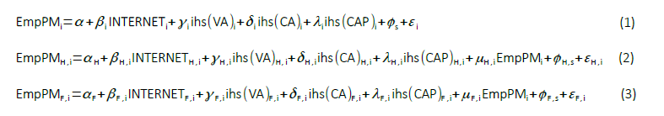

Slide 60
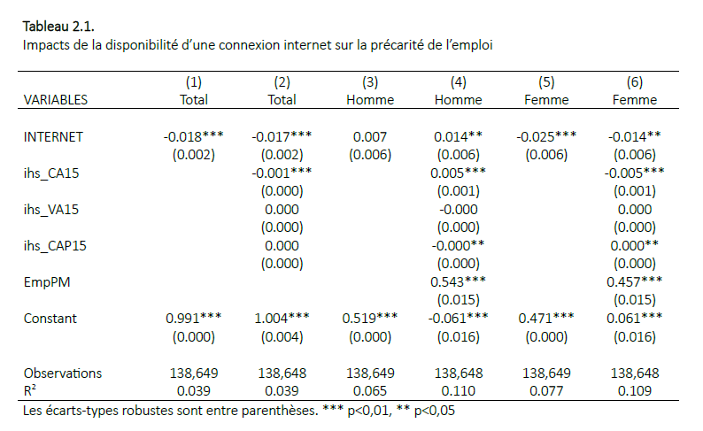

Slide 61
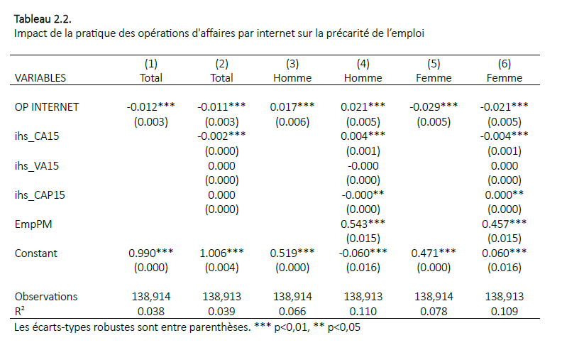

Slide 62
Robustesse des résultats
Régressions supplémentaires : entreprises en activités, entreprises localisés uniquement à Douala et Yaoundé, entreprises qui sous-traitent, secteurs économiques, taille des entreprises (TPE, ME, GE), nature de l’établissement (bureau ou cabinet, éducation, usine ou atelier, etc.), sexe du promoteur, statut matrimonial du promoteur, diplôme du promoteur, promoteur avec une formation, etc.
Endogénéité : instrumentation de la disponibilité d’une connexion internet (de la pratique des opérations d’affaires par internet) par la part moyenne de la disponibilité d’une connexion internet (de la pratique des opérations d’affaires par internet) dans la catégorie juridique des entreprises
Conclusion : les résultats de base sont confirmés principalement dans le secteur tertiaire.

Slide 63
VI-Conclusion
En contribuant à la substitution d’une partie des travailleurs, tout comme cela a été observé dans d’autres pays, la disponibilité ou l’utilisation des TIC semble contribué à la polarisation de l’emploi au Cameroun. Cette étude révèle surtout que cela semble concerner uniquement les employés femmes dans le secteur tertiaire.
Limites: recherche de l’explication des effets opposés selon le sexe et nécessité d’utiliser des données en panel ou des données du dernier recensement des entreprises au Cameroun pour confirmer ce résultat.

Slide 64
Merci d’avance pour vos questions et suggestions

Slide 65




"Ethnographie des mobilisations " Auchan dégage " et " Auchan reste " au Sénégal : acteurs, discours, idéologies et rationalités
< ManaGlobal final conference - France, Rennes, 15-16 may 2024 >
Co-directed by :
Professor Ulrike SCHUERKENS (UR2)
Professor Sylvain Landry FAYE (UCAD)
Presented by :
Paul Mamba DIÉDHIOU
Ph.D-Candidate (UCAD and UR2) < ManaGlobal final confErence 2024>

Slide 66

Presentation outline
Ethnography of the "Auchan stays" mobilisations
Premises - "Auchan" in Senegal: a controversial multinational?
Ethnography of the "Auchan dégage" mobilisations
Conclusion

Slide 67


Premises - "Auchan" in Senegal: a controversial multinational?
Auchan" to open in Senegal, a former French colony, in 2014
  38 chain stores: 1 drive-through, 1 hypermarket, 20 supermarkets, 16 convenience stores
  1900 employees and + 1500 employees https://www.auchan-retail.com/fr/location/auchan-retail-senegal/#:~:text=Auchan%20Retail%20Senegal%20account%2038,and%2016%20stores%20of%20nearby, consulted on 8 May 2024.
Auchan's presence on the local market is highly controversial
  Auchan dégage" protests: disruption of the local market
  Auchan reste" mobilisations: reconfiguring the local market
Issue - How can we analyse the "Auchan dégage et Auchan reste" protests/mobilisations? Who are the real players behind them? What are their rationale, objectives, ideologies and motivations? What are the Senegalese people's perceptions of the various mobilisations? To what extent do these mobilisations induce "Auchan" behaviour?

Slide 68
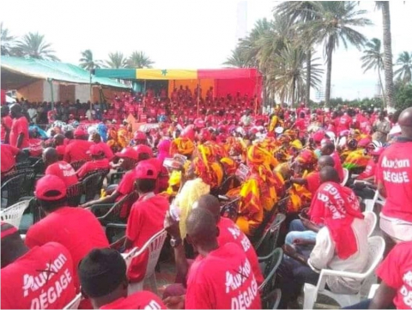
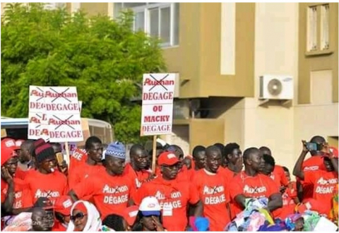
Ethnography of the "Auchan dégage" mobilisations: actors, ideologies and rationalities

Slide 69
Players in the "Auchan dégage" protests
Associations
ADEC = Association for the Defence of Consumers
ASDEC = Senegalese Association for the Defence of the Environment and Consumers
FOJCOSEN = Forum of Young Consumers of Senegal
FRAPP = Front for a Popular and Pan-African Anti-Imperialist Revolution
SOS consumers
Employers' organisations
CNP = Senegalese National Employers' Council
COCOGES = Collectif des Femmes Commerçantes du Groupement Économique Sénégal (Collective of Women Traders of the Senegalese Economic Grouping)
JOLIBA = Youth Working Freely for the Interest and Welfare of Africa
MDES = Mouvement des Entreprises du Sénégal
SEN BIO
UCMC = Union des Commerçants du Marché Castors (Castors Market Traders' Union)
UNACOIS = National Union of Merchants and Industrialists of Senegal
UNCCIAS = National Union of Chambers of Commerce, Industry and Agriculture of Senegal

Slide 70
Motivations of those involved in the "Auchan dégage" protests
Associations
Food sovereignty, an issue requiring an organised collective approach, promotion of local development, activism for local consumption (ADEC, DSDEC, FOJCOSEN, SOS consommateurs, FRAPP)
Refusing to leave the food chain in the hands of foreign investors ("Doomi reew moy tabax reew"), fighting for the employability of young people and getting "Auchan" (FRAPP) out of business.
Employers' organisations
Protection of small businesses (CCIAD, CNES, SNP, UNACOIS)
Make the authorities understand that supermarkets are killing small local businesses to get them to react (Sen Bio, UCMC)
Encouraging local producers and local consumption, eating organic (UNACOIS)

Slide 71
How do the players behind the "Auchan dégage" protests view the multinational " Auchan "?

Slide 72
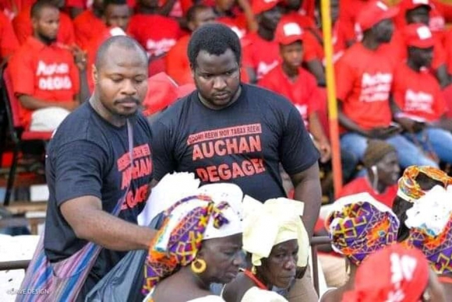
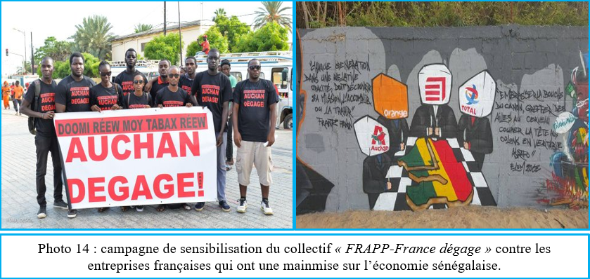
Auchan dégage" protests: an "anti-French" prerogative
"Auchan dégage" = distrust, if not criticism, of these supermarket giants, accused of abusive commercial practices, unfair competition and aggressive pricing.
Senegal = a cake to be shared by the giant French companies: "Auchan" in the food distribution sector, "Orange" in the telecommunications sector, "Eiffage" in the road construction sector and "Total" in the hydrocarbons sector.

Slide 73
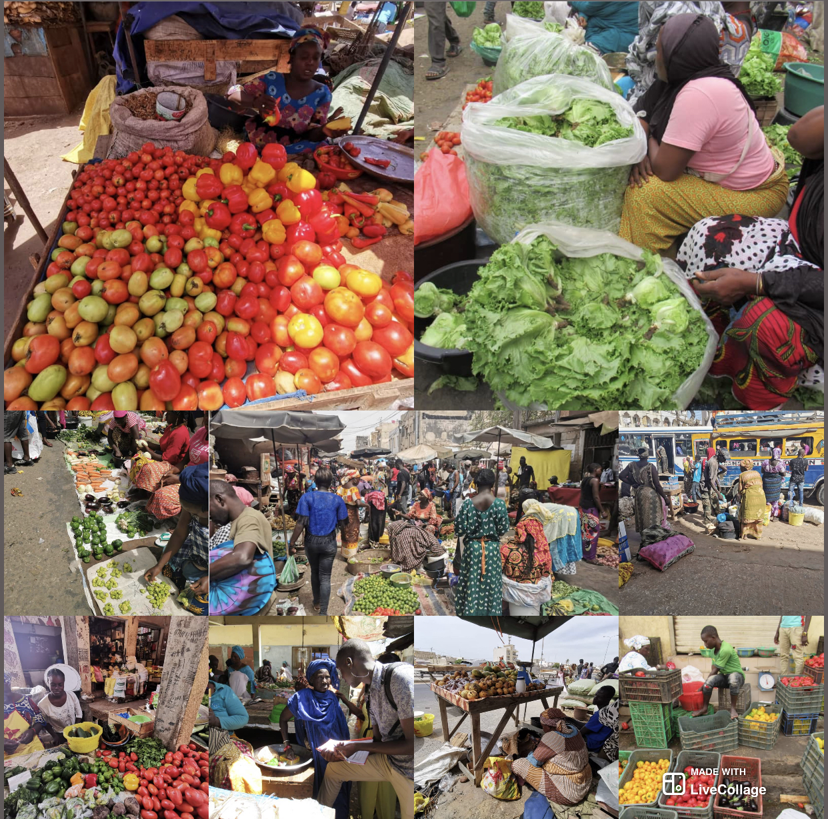
Auchan dégage" protests: a plea for local consumption
"Auchan dégage" illustrates how small vendors, producers and urban consumers can unite to defend local food systems and fight against the expansion of supermarkets and multinational food companies.
"Auchan dégage" = an opportunity for debate on the need to rethink economic and commercial policies to protect the local economy, the fruit of local consumption.

Slide 74
"Auchan dégage": repertoires of actions, impacts and limits
Aspects/elements | Features
Stock directories | March, non-violent demonstration on the public highway and distribution of flyers, awareness-raising at markets on the importance of eating locally and preserving the cultural heritage of food and cooking, occupation of premises: sit-in in front of the Ministry of Trade, publicising intimidation and arrests during these events, national awareness-raising tour (visits by religious authorities).
Impacts identified and results obtained | Audience with the President of the Republic, publication of a presidential decree regulating the location of supermarkets, ministerial order setting out the practical arrangements for establishing the distance of 800 m as the crow flies between two supermarkets and at least 1,000 m between a supermarket and a local market.
Mobilisation limits | Non-involvement of certain retailers' organisations, lack of continuity in campaigns, lack of consumer support for campaigns

Slide 75

Ethnography of the "Auchan reste" mobilisations: actors, ideologies and rationalities

Slide 76
Auchan reste" mobilisations: actors, ideologies and rationales
  Proposal for lower prices (Mor Yombalé) = foolproof strategy for installation
  Innovation in terms of comfort, purchasing and extended opening hours
  Helping to create jobs for young people (over 1,700 jobs, 75% of whom are under 35, according to Laurent Leclerc, CEO of Auchan Retail Senegal (https://www.auchan-retail.sn/fr/contenu/valeurs/auchan-senegal-introduction). Accessed on 2 March 2022), a source of economic patriotism.
  60% balance of local products = 100% meat and fish and 90% fruit and vegetables, a plea for local consumption
  Democratisation of supermarkets = presence in towns and suburbs offering access to the working classes
  Auchan inspires local traders and is a source of supply for stallholders (case studies)
Players
Initiator= consumers via social media
Members=Union national des consommateurs (UNCS) local shopkeepers inspired by Auchan and stallholders, Auchan relays

Slide 77
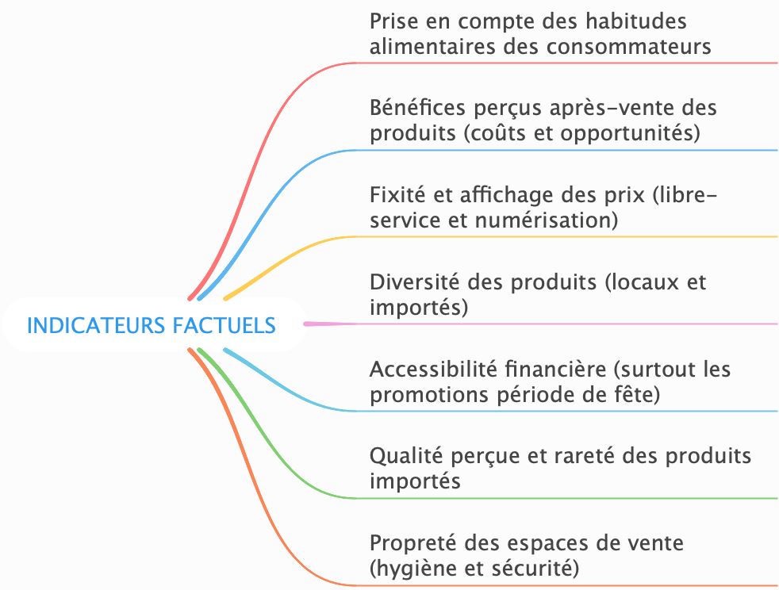

What are the factual indicators of the "Auchan remains" mobilisations?

Slide 78
What can we learn from this?
Mobilisations around the multinational "Auchan", ("Auchan dégage" and "Auchan reste") demonstrating a series of particular interests of the stakeholders involved.
If some consumers have joined the "Auchan reste" movement, it is because the "Auchan" brand has in some way satisfied their food needs: costs and opportunities, diversity of products, and so on.
However, local shopkeepers have felt threatened by the presence of "Auchan", through its advocacy of local consumption (sale of local products), the result of fierce competition, sometimes leading to the loss of customers, or even their disappearance, conversion and bankruptcy.

Slide 79
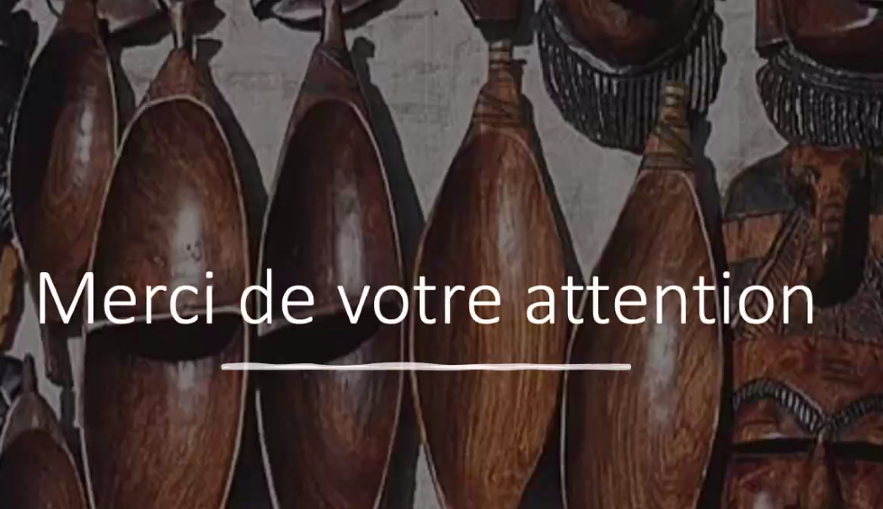

PhD. Student Paul Mamba DIÉDHIOU
UCAD/ETHOS/LASAP (Senegal)
UR2/STT/LiRIS (France)
paulinnho92@gmail.com

Slide 80
Rôle du capital social sur la résilience des entrepreneurs dans la chaîne de valeur de la pêche artisanale au Sénégal durant la pandémie du covid-19
Thierno Ndao GUEYE, Université Assane Seck de Ziguinchor
Seydi Ababacar DIENG, LAREM – UCAD
Conférence de Clôture du Projet MANAGLOBAL
15-16 mai 2024, Université Rennes 2

Slide 81
Plan de la présentation
Intérêt de la recherche, question et objectifs
Hypothèses et méthodologie
Résultats
Préconisations
Limites de la recherche

Slide 82
Intérêt de notre étude
Enrichir un domaine de recherche très peu exploité
  La revue de la littérature sur la résilience organisationnelle.
  Le rôle des ressources territoriales sur l’essor du capital social.
  Le rôle du capital social sur la résilience des entrepreneurs durant la pandémie du covid-19
Résultats empiriques seront d’un grand intérêt managérial et de politique économique
  L'évaluation de la résilience organisationnelle peut devenir un outil d'aide à la décision important pour les PME du secteur de la pêche artisanale, les décideurs politiques et institutions financières.

Slide 83
Question de recherche 2/4
Situation économique de la pêche artisanale au Sénégal
Richesse créée par l’activité de pêche maritime et de la transformation : 2,3% du PIB en 2019. Les exportations de produits halieutiques : 2,5% du PIB (ANSD, 2021)
Le secteur de la pêche artisanale regroupe plusieurs activités : la pêche comme activité sous-jacente et plusieurs activités connexes comme le mareyage, transformation, négoce, services, vente d’équipements.
Les pêcheurs artisanaux sont issus des communautés littorales qui ont un certain ancrage ethnique, familiale et traditionnel.

Slide 84

Question de recherche 1/4

Slide 85

Question de recherche 3/4

Slide 86
Question de recherche 4/4
  Des travaux scientifiques sur les liens capital social- résilience des entrepreneuriale contexte d’incendies, tremblements de terre, tsunamis, etc.
  Comment cette relation s’applique chez les entrepreneurs du secteur de la pêche artisanale maritime (pêcheurs, mareyeurs, transformateurs) durant la pandémie du Covid-19 ?
  Quel est le rôle des ressources territoriales dans le développement du capital social de ces entrepreneurs ?
  Comment le capital social a participé à renforcer la résilience de ces entrepreneurs durant cette crise ?

Slide 87
Objectifs
Objectif général
  Analyser la manière dont le capital social des entrepreneurs de la chaîne de valeur de la pêche artisanale maritime a influencé leur résilience entrepreneuriale durant la pandémie du Covid-19.
Objectifs spécifiques
  Analyser l’effet des ressources territoriales sur l’essor du capital social des entrepreneurs durant la crise du Covid-19.
  Analyser l’effet du capital social des sur la résilience entrepreneuriale des acteurs de la pêche.
  Apprécier l’effet de l’accès au crédit, aux Fonds publics de garantie et aux subventions sur la résilience entrepreneuriale des acteurs de la pêche.

Slide 88
Hypothèses
  H1 : Les ressources territoriales ont une influence positive et significative sur l’essor de capital social des entreprises du secteur de la pêche artisanale durant la pandémie du Covid-19.
  H2 : Le capital social a un effet positif et significatif sur la résilience des entreprises du secteur de la pêche artisanale durant la pandémie du covid-19.
  H2a: Le capital social de type bonding a un effet positif et significatif sur le résilience des entreprises.
  H2b: Le capital social de type linking a un effet positif et significatif sur la résilience des entreprises.

Slide 89
Démarche méthodologique
  Enquête par questionnaire : menée dans la région de Dakar, Thiès et Ziguinchor, précisément aux centres de pêche de Saint-Louis, Cayar, Mbour, Rufisque, Kafountine et Cap Skiring.
  Etude pilote sur l’instrument d’enquête utilisé auprès des 20 premiers répondants afin de s’assurer de la validité apparente et du contenu.
  Sur 150 pécheurs artisanaux, mareyeurs et transformateurs de produits halieutiques ayant un registre de commerce contactés, 101 ont réellement répondu au questionnaire, soit un taux de réponse de 67,33%.
  Utilisation d’un modèle de régression multivariée

Slide 90
Figure 01 : le Modèle conceptuel de recherche
Les caractéristiques de l’entreprise
Les caractéristiques de l’entrepreneur
Résilience entrepreneuriale
Ressources territoriales
Produits halieutiques
Connaissances: savoir, savoir-être et savoir-faire localisé, transmis de génération en génération
Variable à expliquer
Capital social
- Liens de type bonding
- Liens de type Linking
Variable médiatrice
Variables explicatives
Source : Auteurs

Slide 91
Résultats
Echelles | Moyenne Echelle | Alpha de Cronbach | Rho | AVE
Ressources territoriales | 3,65 | 0,712 | 0,877 | 0,78
Capital social de type bonding | 3,03 | 0,684 | 0,841 | 0,721
Capital social de type linking | 2,89 | 0,815 | 0,89 | 0,73
Résilience entrepreneuriale | 3,13 | 0,834 | 0,879 | 0,836
.
Corrélation
 | Ressources territoriales | Résilience entrepreneuriale
Capital social de type bonding | 0,417** | 0,307***
Capital de type type linking | 0,349*** | 0,287**
Régression | Variable dépendante
Régression | Ressources territoriales | Résilience entrepreneuriale
Capital social bonding | 0,166** (0,082) | 0,293*** (0,045)
Capital social linking | 0,079 (0,031) | 0,147** (0,077)
Caractéristiques de l’entreprise |  | 0,018* (0,016)
Caractéristiques de l’entrepreneur |  | 0,006* (0113)
* sig. 10% ; ** sig. 5% ; ***sig. 1%, erreurs standards sont entre parenthèses. N=101

Slide 92
Préconisations
Elle permet de dresser un portrait plus représentatif de la résilience entrepreneuriale des PME sénégalaises du secteur de la pêche artisanale et de proposer des moyens ciblés pour augmenter leur résilience.
Une préoccupation majeure du gouvernement sénégalais dans la modélisation des politiques économiques des secteurs économiques stratégiques comme celui de la pêche artisanale.

Slide 93
Limites de la recherche
On a pas fait le maillage national des des entreprises du secteur de la pêche artisanale afin prendre en compte certains spécificités locales.
Utiliser le modèle d’équations structurelles afin de prendre en compte les interactions entre différentes variables.
On a pas fait des tests de robustesse du modèle.

Slide 94
    MERCI DE VOTRE AIMABLE ATTENTION

